Slide 1
Site Survey Figures

Slide 2
Strategic Plan & Scope
High Level Network Architecture
Network Design
Deployment
Operations & Maintenance
Field Maintenance
Post-Launch Engineering
Supply Chain Management
Network HLD
Selected Equipment & Vendors
Business Strategy
Deployment
Deployment Management
Site Survey
Site Construction Management
Installation and Commissioning
to Operations
Civil & Power Design

Slide 3
Pre-Work
Site Survey Activities
Documentation
High-Level Design Reports (RAN / TX)
Site Engineering information (Existing Site)
Soil/Terrain Information (New Site)
Local Map
Existing services (energy, communications, etc.)
Site’s basic information
Site Survey Report Generation
Use Case Identification
Civil Infrastructure
Data Collection
Data Filtering
Power Supply
Resource Preparation
Image Edition
Telecom Infrastructure
Format Editing
Team Gathering
RF Requirements
Layouts Generation
Survey Plan & Logistics
TX Requirements
Best Practices
Input
Activity
Output

Slide 4
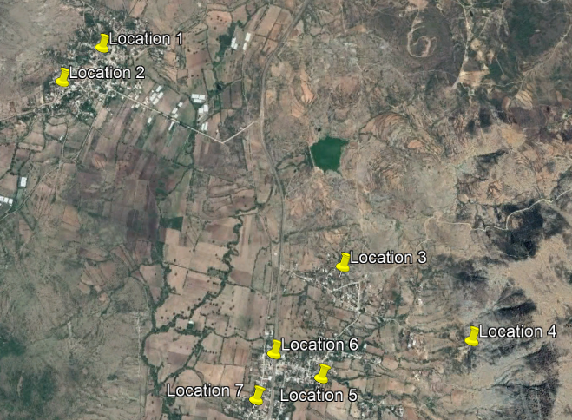

Slide 5
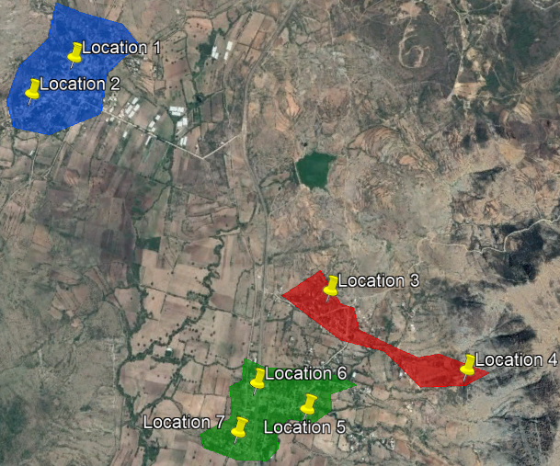

Slide 6
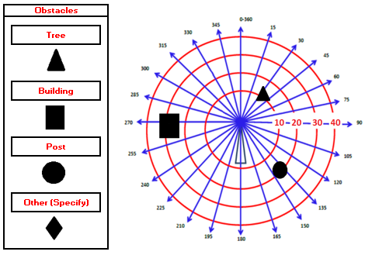

Slide 7
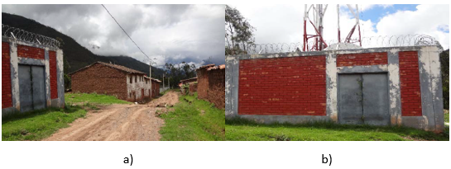

Slide 8
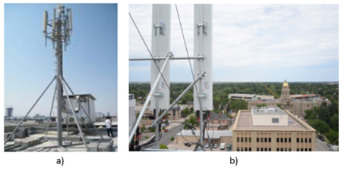

Slide 9
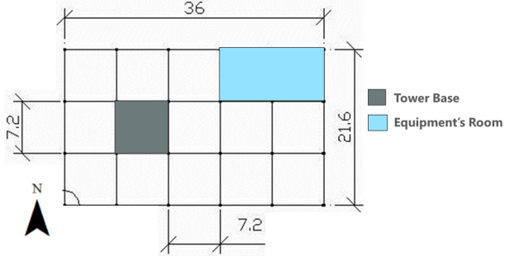

Slide 10
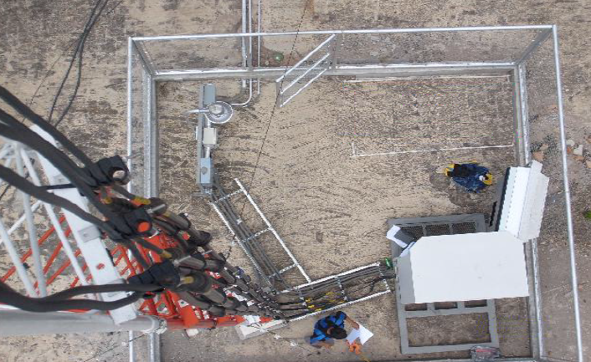

Slide 11
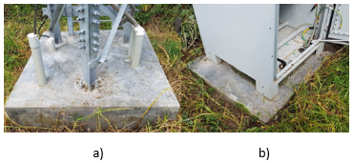

Slide 12
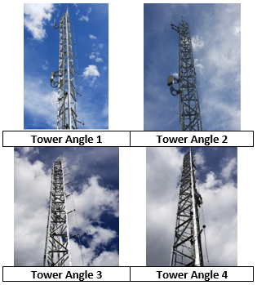

Slide 13
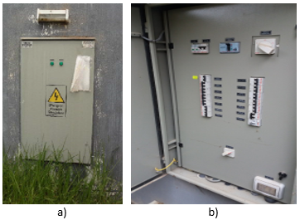

Slide 14
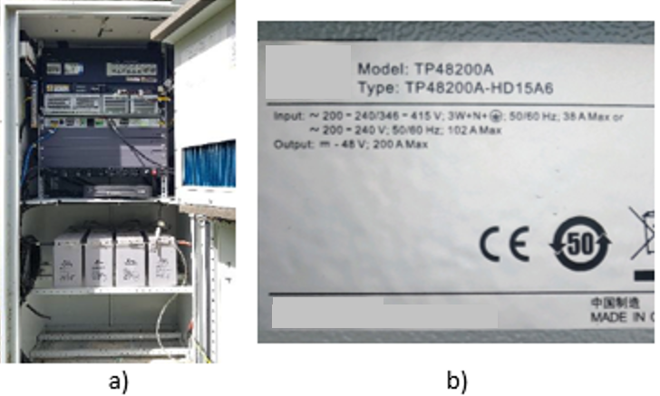

Slide 15
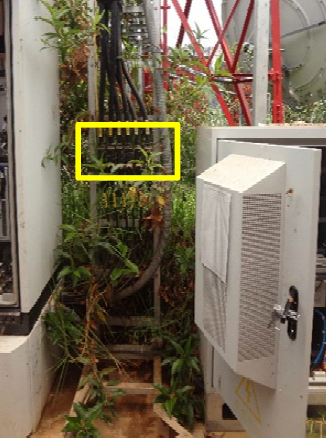

Slide 16
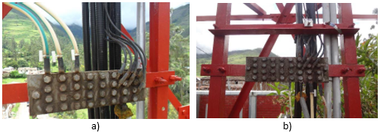

Slide 17
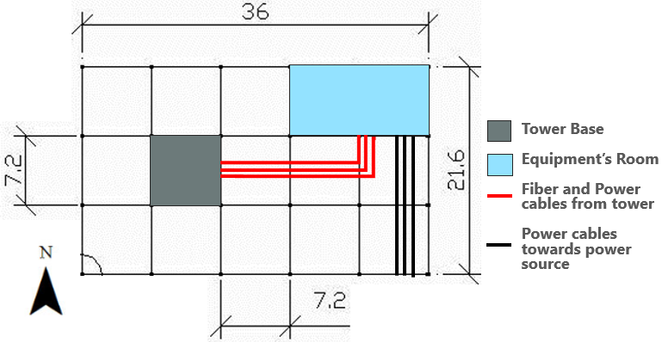

Slide 18
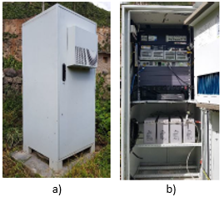

Slide 19
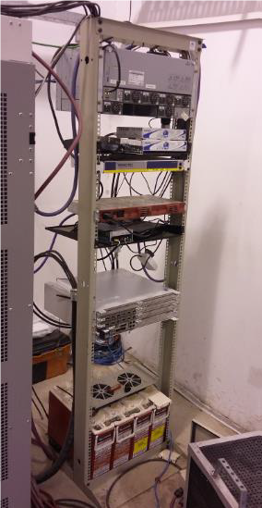

Slide 20
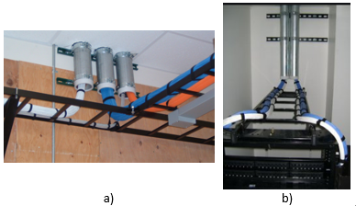

Slide 21
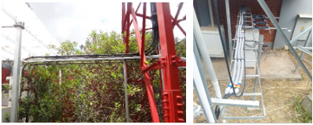

Slide 22


Slide 23
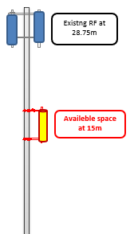

Slide 24
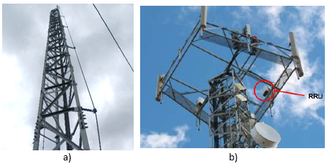

Slide 25
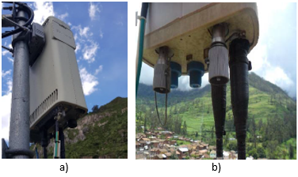

Slide 26
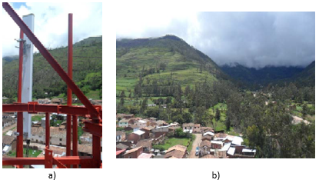

Slide 27
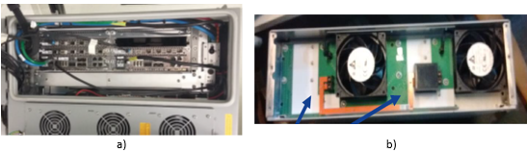

Slide 28
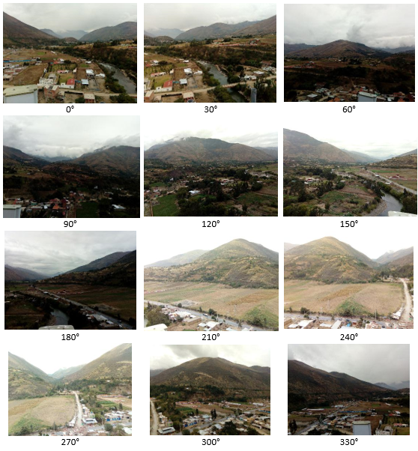

Slide 29
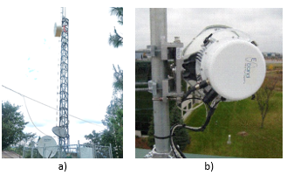

Slide 30
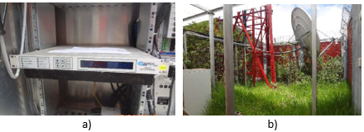

Slide 31
